Slide 1
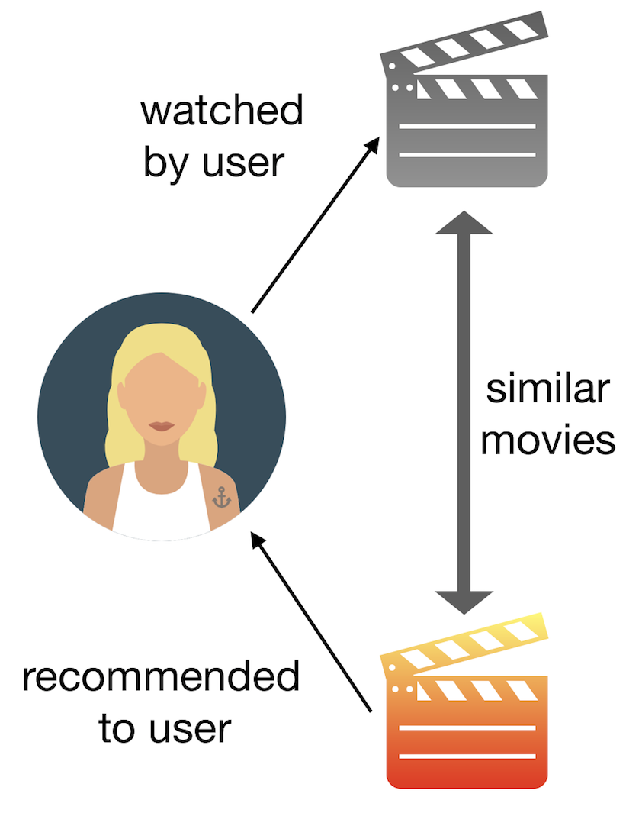
Movie Recommendation System
Module 4 by: Payam Abbasi
Date: 10/19/20
Program: ds-pt-030220

Slide 2
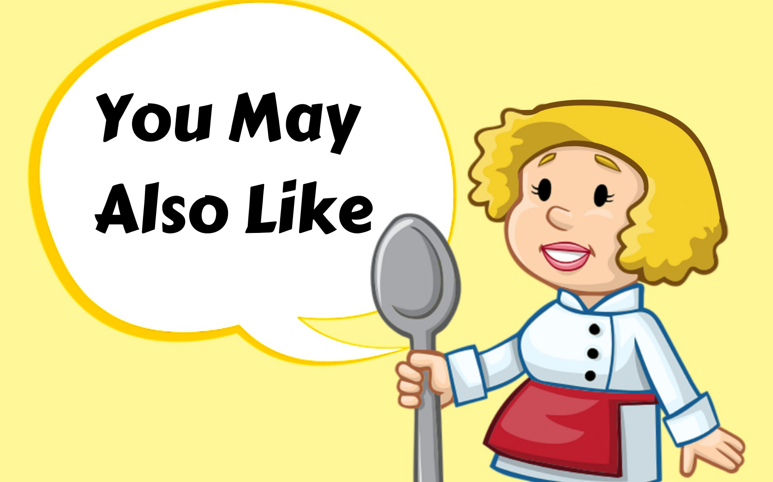
Why The Recommendation Systems?
Benefits users in finding items of their interest.
Help item providers in delivering their items to the right user.
Identity products that are most relevant to users.

Slide 3
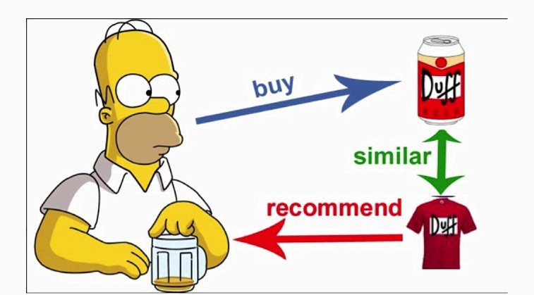





Who Uses The Recommendation Systems?

Slide 4

Objective
To build a model that provides top 5 movie recommendations to a user, based on their ratings of other movies from a database from the University of Minnesota.

Slide 5
Methodology
Data Processing
Data Modeling
Model Evaluation
movie_name
movieID
ratings_data
movieID
movie_data = movie_name + ratings_data ON movieID

Slide 6
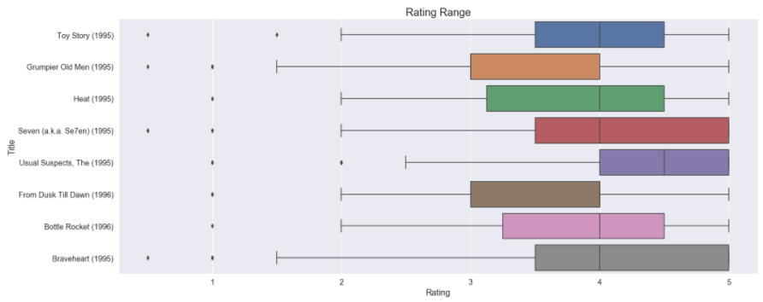
Rating Range Per Movie

Slide 7
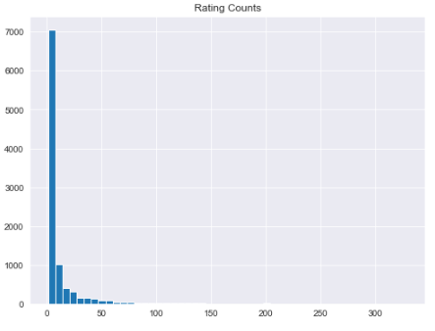
Rating Counts

Slide 8
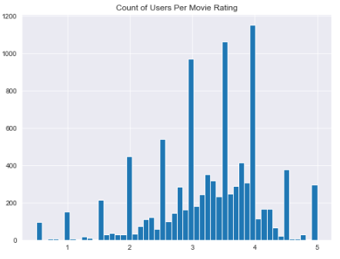
Count of Users Per Movie Ratings

Slide 9
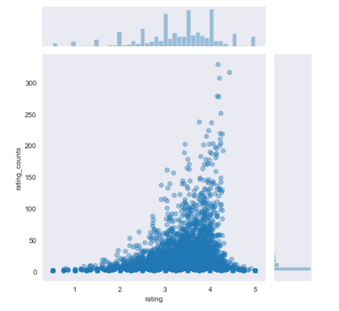
Outliers

Slide 10
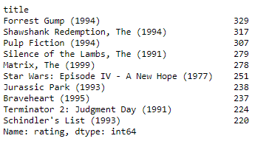
Sorting in Descending Order Based On Counts

Slide 11
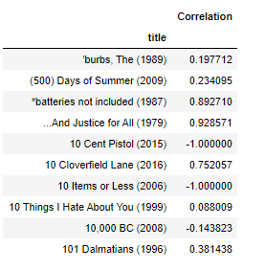
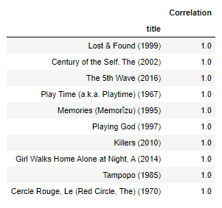
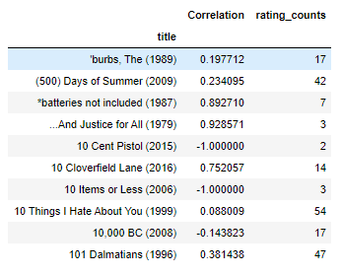
Correlation
Correlation between the user ratings for the "Forest Gump (1994)"
Correlation between the user ratings for the "Forest Gump (1994)“ - Descending
Correlation between the user ratings for the "Forest Gump (1994)“ – Rating Counts

Slide 12
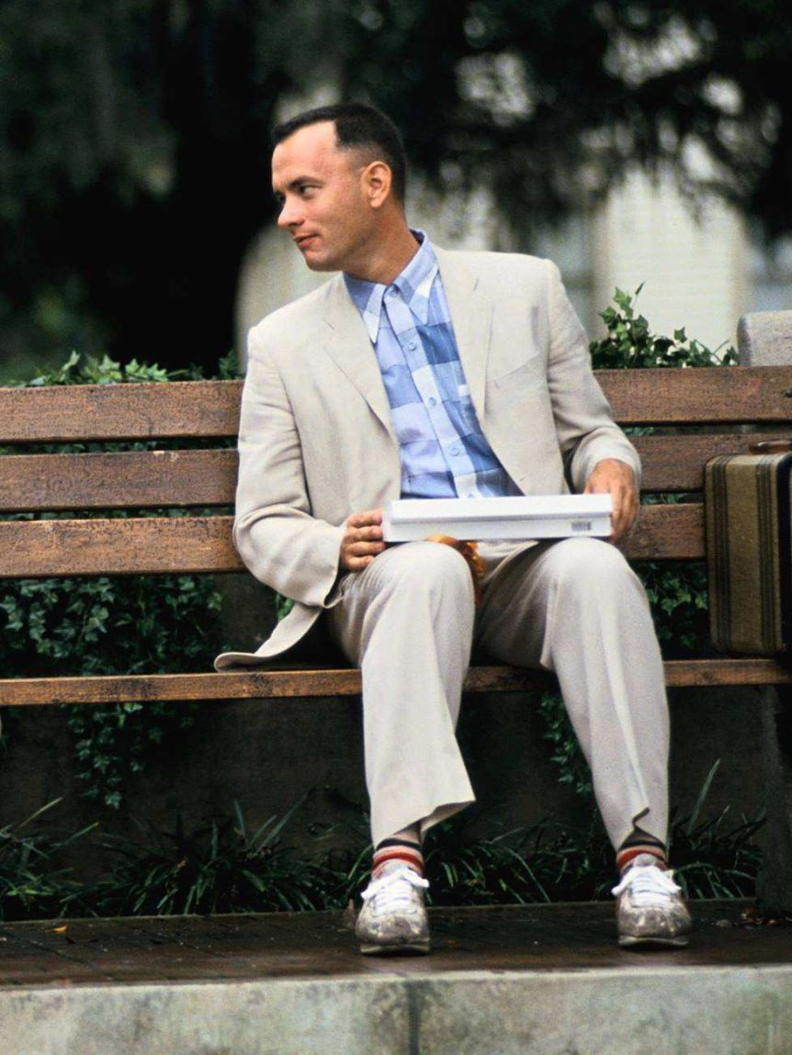
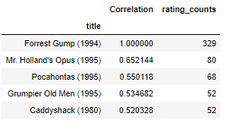
We recommend the following 5 movies if you like “Forest Gump”

Slide 13

Future Work
Build more recommendation systems and test them out.

Slide 14


